Slide 1

Lecture 2.1
Python Fundamentals

Slide 2

A G E N D A
Python
Basics of python
Data structures in Python
Control Structures in Python
Loops & Transfer Statement in Python
Functions
Environment Setup
Tools Installation?
Jupyter Notebook Setup and Usage

Slide 3
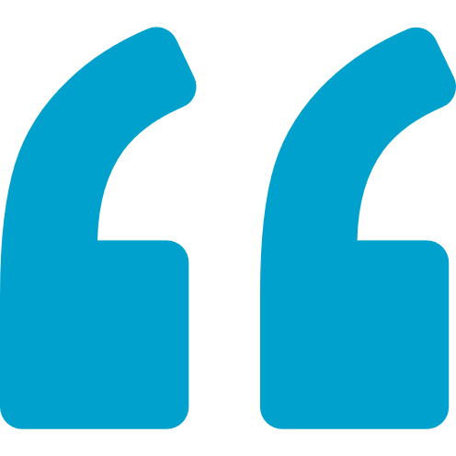

Introduction
Open Source general purpose programming language
Object Oriented
Programming as well as scripting language
Python is a general-purpose programming language that is often applied in scripting roles

Slide 4

Features
Easy to learn & use
Interpreted language
Open Source
Large Standard Library
Large Community Support
Extensible
Cross-platform language

Slide 5
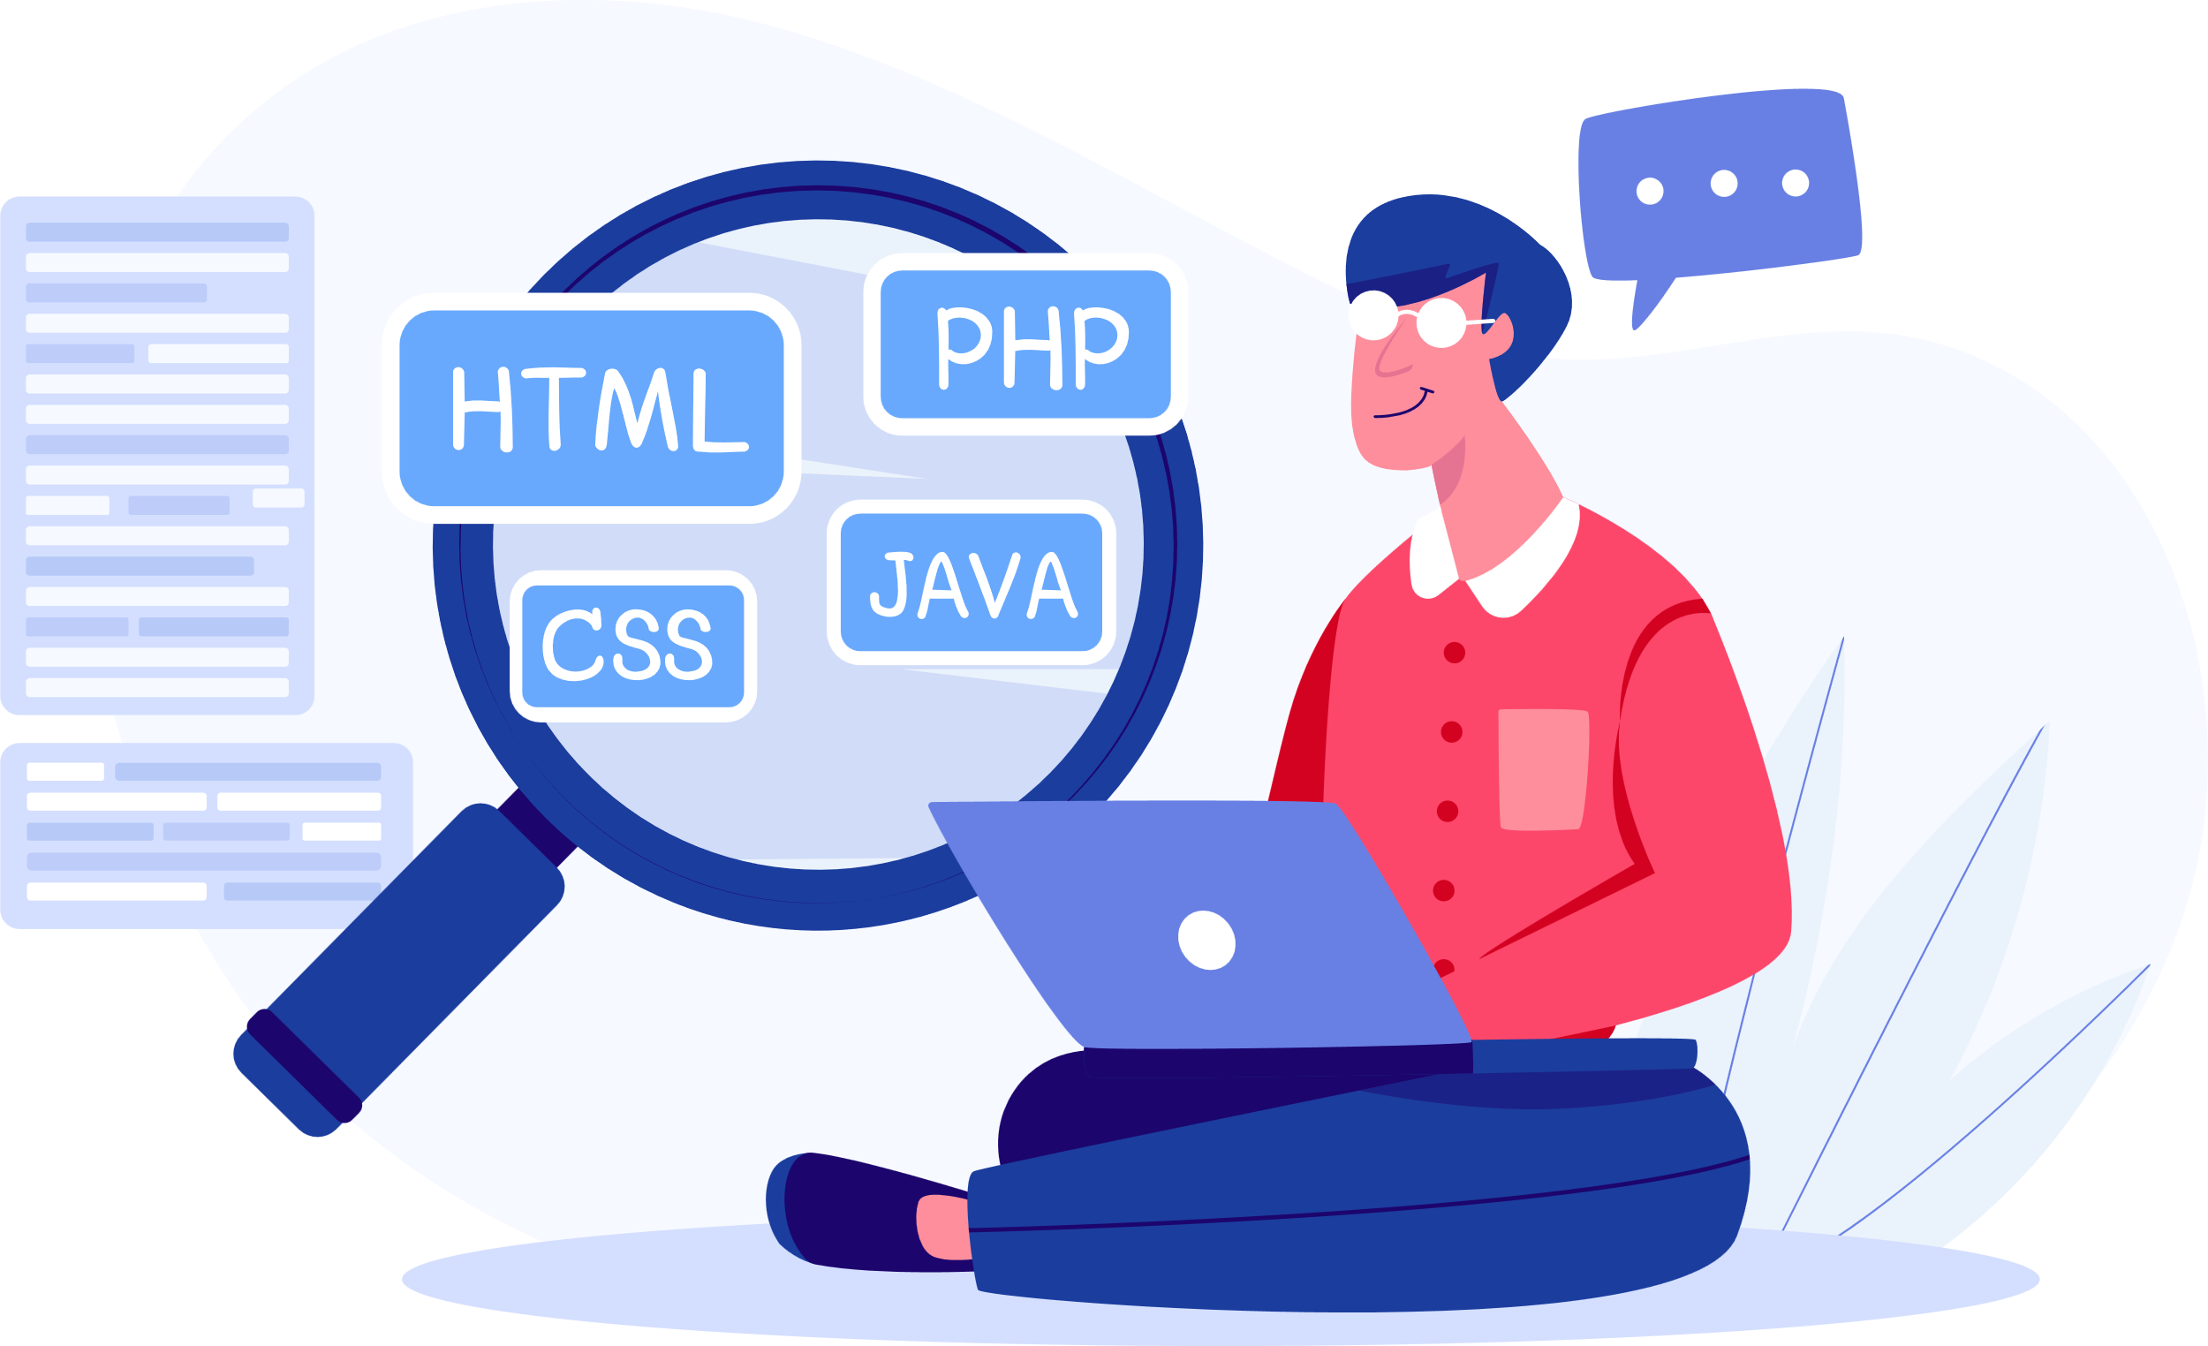
Python vs other programming language
More user-friendly
More applications
Stability
Speed

Slide 6
Basics of Python

Slide 7

Variables
You can consider a variable to be a temporary storage space where you can keep changing values.
Assigning values to a variable:
To assign values to a variable in Python, we will use the assignment (=) operator.
a = 10, a = “Welcome to the class”
No need to declare the datatype of the variables done in other programming languages

Slide 8
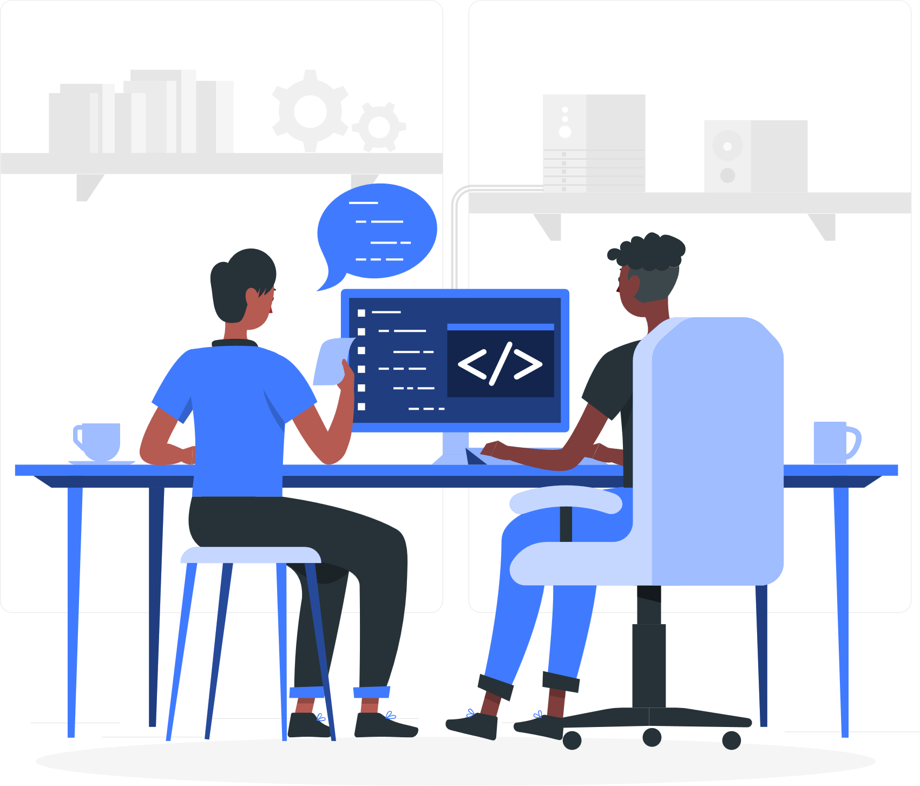
Keywords
Special reserved words which convey a special
Meaning to interpreter or compiler.
It can’t be used as a variable.
Few of the example keywords are as follows:
def,
else, if,
class,
continue,
break,
finally,
from,
return,
lambda,
except,
import,
None

Slide 9
Data Types
Variables hold values of different data types.
With the help of type() function you can check the type of variable used.
Datatype
Immutable
Mutable
Numbers
Strings
Tuples
Lists
Dictionaries
Sets

Slide 10
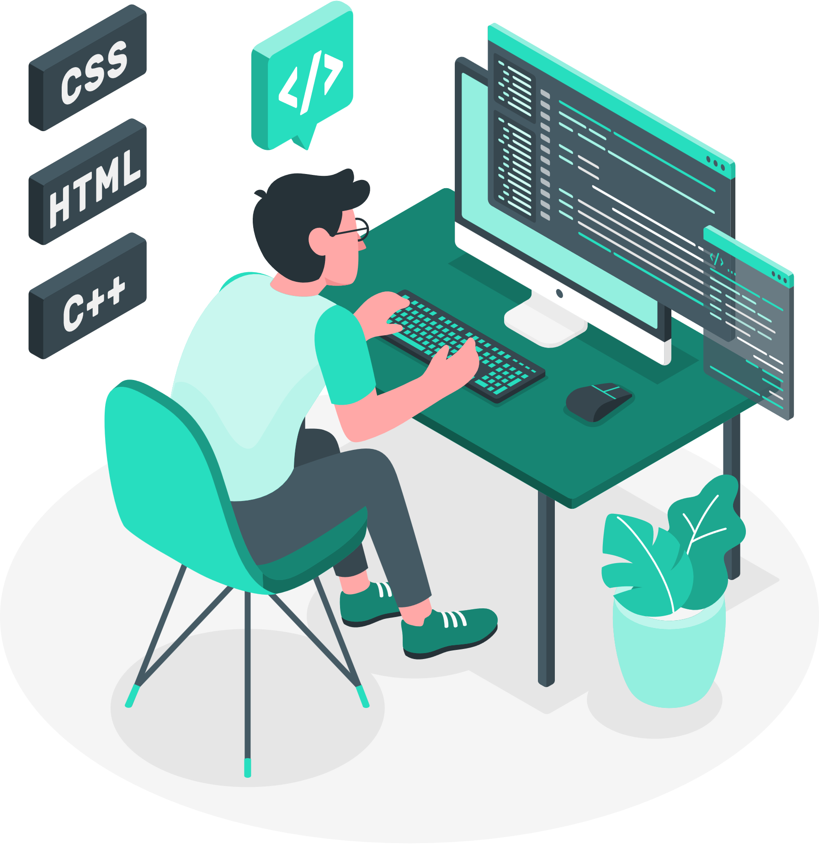
Operators & Operands
Operators are special symbols that represent computations like addition and multiplication.
Value of operators is applied to are called operands.
Operator : -, +, /,*,**
20+32, hour-1, hour*60+minute 5**2
Order of Precedence : PEMD (Parenthesis, Exponentiation, Multiplication and Operators)

Slide 11
Data Structures in Python

Slide 12

Lists
List is a sequence of values of any type.
Values in lists are called as elements or items. [10, 20, ‘Class’]
A list within another list is nested.
Lists are mutable.
It has variable length.
Lists are accessed similarly like arrays. First element will be stored at 0th index.
Let’s discuss function used in lists.

Slide 13
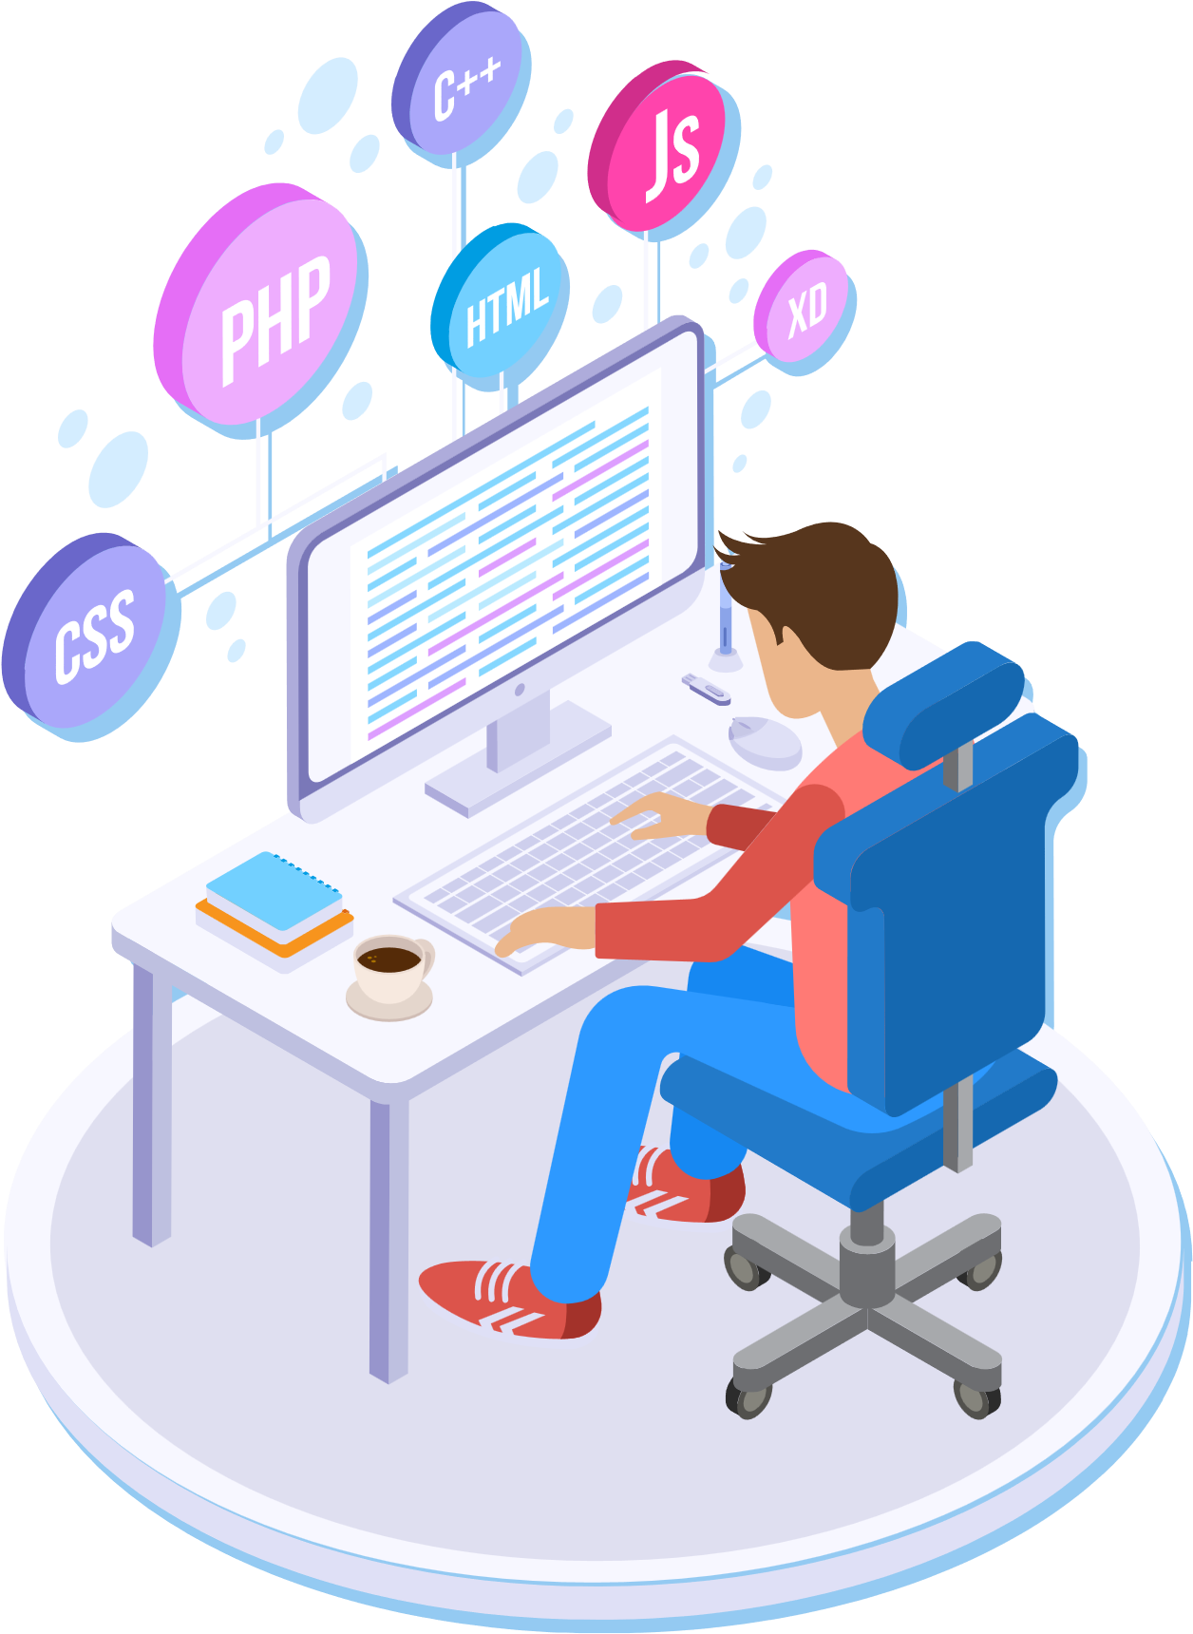
Tuples
Tuples are similar like lists, having a sequence of values of any type and enclosed within parentheses.
Tuples are immutable.
It has fixed length.
tup_1 = (‘a’, 1, ‘df’, ‘b’)
Let’s discuss about the functions of tuples.

Slide 14
Lists vs Tuples
Items surrounded in square brackets []
Lists are mutable in nature
There are more than 40 available methods in Lists.
If content is not fixed, and keeps on changing then we should go for lists.
List objects cannot be used as keys for dictionaries because keys should be Hash table and immutable.
Items surrounded in round brackets ()
Tuples are immutable in nature
There are almost 30-35 available methods in Tuples.
If content is fixed, and never changes then we should go for Tuples.
Tuple objects can be used as keys for dictionaries because keys should be Hash table and immutable.

Slide 15

Sets
Unordered collection of items is known as set.
Items of set can not duplicate. Colors = { ‘red’, ‘blue’ , ‘green’ }
Let’s see how to use, Union, Intersection methods in set.
Let’s discuss about the other functions of Sets.

Slide 16
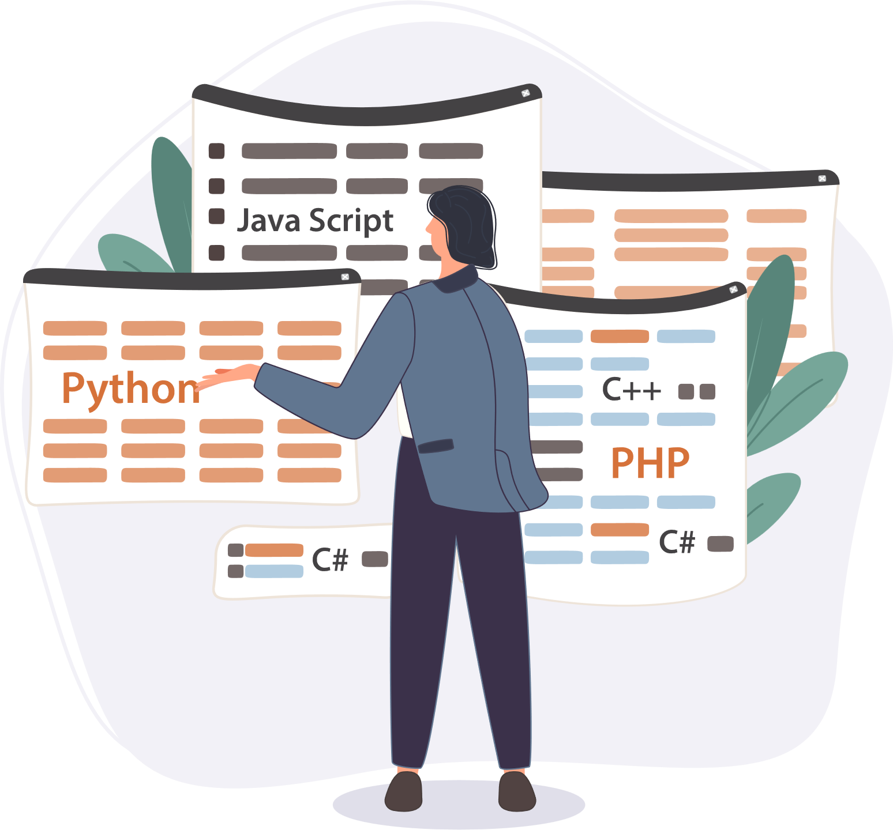
Dictionary
Unordered collection of data.
Data in dictionary is stored as key:value pair.
Key should not be mutable and value can be of any type.
Dict = { “name”: “begindatum”, ‘age’:10 }
Keys: name and age
Values: begin at number and 10
Let’s see how to access the keys, and values in dictionary along with different functions used.

Slide 17
Python Control Statements

Slide 18
Control Statements
1
Conditional statements
2
The flow control statements are divided into three categories
Iterative statements.
3
Transfer statements

Slide 19
Conditional Statements
There are four types of conditional statements
01
02
03
04
if statement
if-else
if-elif-else
nested if-else

Slide 20
If- statement
Syntax
Example
if condition:
statement 1
statement 2
statement n
number = 6
if number > 5:
print('/talentlabs')
Execute the code block if the expression is True

Slide 21
If-else statement
Syntax
Example
if condition:
statement 1
else:
statement 2
password = input("Enter password")
if password == "/talentlabs@10":
print("Correct password")
else:
print("Incorrect Password")
Execute the code block under the “if” branch if the expression is True else execute another code block under the “else” branch

Slide 22
If-elif-else statement
Syntax
Example
if condition-1:
statement 1
elif condition-2:
statement 2
else:
statement
def user_check(choice):
if choice == 1:
print("Admin")
elif choice == 2:
print("Editor")
else:
print("Wrong entry")

Slide 23
Nested If-else statement
Example
num = float(input("Enter a number: "))
if num >= 0:
if num == 0:
print("Zero")
else:
print("Positive number")
else:
print("Negative number")

Slide 24
Python Loops (iterative statements)

Slide 25

What are Loops?
One of the main purpose of computer is to help doing repetitive tasks for human
Loops = repeating a piece of code multiple times
2 types of loops (almost universal in all programming languages)
While Loop
For Loop

Slide 26
When do we need Loops?
Loop through a list of values/objects
Example: Lists
Repeat a task for multiple times
Example: Repeat a task for 10 times
Do something until a certain conditions is met
Example:
until time is up
until user finished input
until server side has send me the results
Reduce the number of times we need to copy paste the code

Slide 27
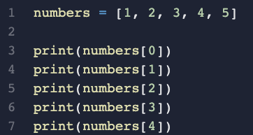
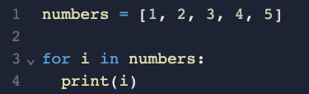
Example
Without Loop
With Loop

Slide 28
For Loop
For loop
for index in sequence:
statements
for i in range(1,10):
print(i)
for i in range(0,5):
print(i)
else:
print("for loop completely exhausted, since there is no break.");
Note: Once for loop is executed, else block is also executed.

Slide 29
Types of For loop
The basic concept: for n times, execute this piece of code
There is only 1 type of “for loop” in Python
for/in - loop through an iterable (i.e. list or range)

Slide 30

For
words = ["apple", "boy", "cat", "door", "egg"]
for i in words:
// Loop Body - do something
}
enter a loop
set i equals to first item
set i to next item
do something
Have next item
End of list

Slide 31
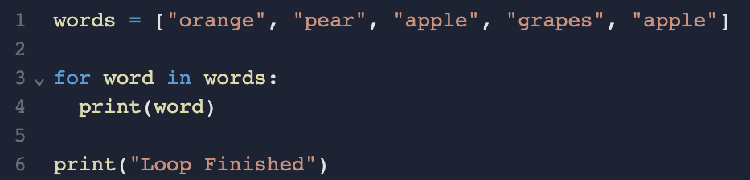
Example

Slide 32
Range
Sometimes, we are not looping through a list, but a range.
Range is a sequence of numbers
You create a range by using the range() function

Slide 33
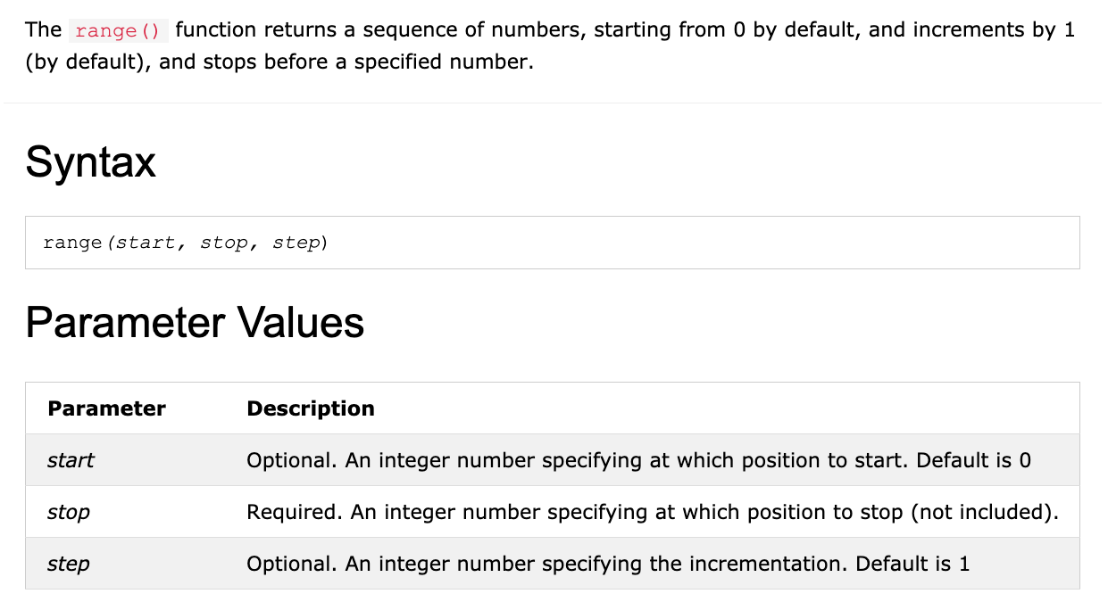
range() function

Slide 34
len() function
The len() function returns the number of items in an object.
When the object is a string, the len() function returns the number of characters in the string.

Slide 35
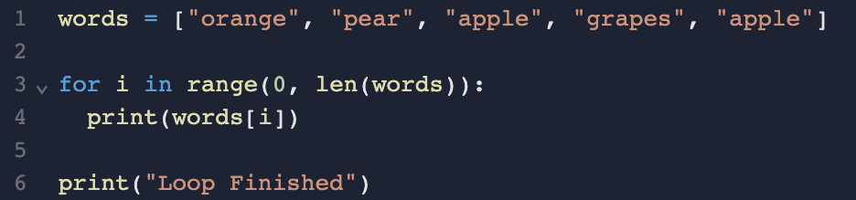
Example

Slide 36
While Loop
While Loop
# Python program to illustrate while loop
count = 0
while (count < 5):
count = count + 1
print("talentlabs")

Slide 37
Types of While Loop
Basic Concept: keep running the piece of code until a specific condition is not met
There is only 1 type of while loop in Python
While Loop

Slide 38
While
enter a loop
while condition:
//do something
check condition
True
do something
False

Slide 39
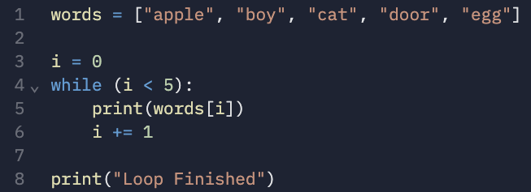
Example
i values Boolean value
0 < 5 TRUE
1 < 5 TRUE
2 < 5 TRUE
3 < 5 TRUE
4 < 5 TRUE
Condition is not met
5 < 5 FALSE

Slide 40
Loop syntax
Loop Using For & While
for iterator_var in sequence
while expression
for iterator_var in sequence:
statements(s)
statements(s)
while expression:
statement(s)
statement(s)

Slide 41
While vs For
numbers = [1, 2, 3, 4, 5]
for i in numbers:
print(i)
print("Loop Finished")
numbers = [1, 2, 3, 4, 5]
i = 0
while i < 5:
print(numbers[i])
i = i + 1
print("Loop Finished")

Slide 42
Python Transfer Statements

Slide 43
Transfer statements
1
Break Statement.
2
There are Three types of Transfer Statements
Continue Statement.
3
Pass Statement.

Slide 44
Break statements
Example
for num in range(10):
if num > 5:
print("stop processing.")
break
print(num)

Slide 45
Ending the Loop Before It Ends
Sometimes, you want the loop to stop before it ends naturally
Consider a scenario:
I want to loop through a list of words, and see if the list contains the word “apple”
I found that the word is at the 3rd position, do I still need to continue?
You can use the “break” keyword to end the loop immediately (ending the whole loop, no further rounds/iterations)

Slide 46
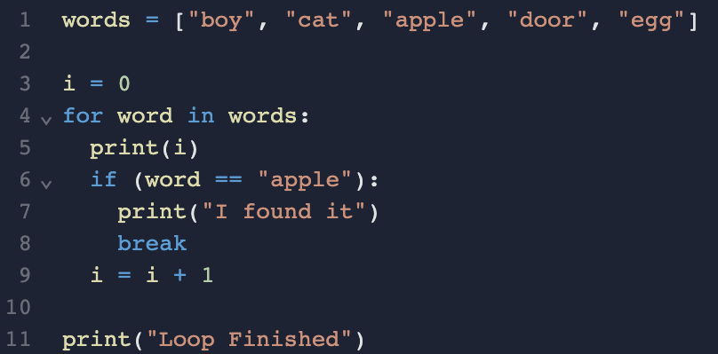
Breaking a Loop

Slide 47
Continue statements
Example
for num in range(3, 8):
if num == 5:
continue
else:
print(num)

Slide 48
Skipping an Iteration
Sometimes, you want to skip one iteration
Consider a scenario:
I want to loop through a list of fruits, count the number of “apple” in the list
For those that are not “apple”, there is nothing that I need to do
For those that are “apple”, I need to increase the count
You can use the “continue” keyword to end the current round/iteration (but the loop will still go on for the next round)

Slide 49
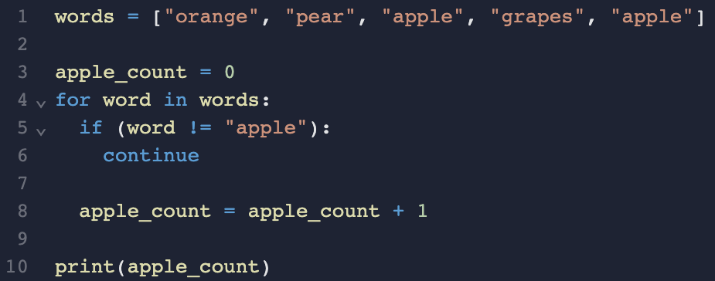
Skipping an Iteration

Slide 50
Pass statements
Example
months = ['January', 'June', 'March', 'April’]
for mon in months:
pass
print(months)

Slide 51
Skipping an Iteration
In Python, the “pass” statement is a null operation. It doesn't do anything but is used as a placeholder where Python expects code.
Certain syntax structures like loops, functions or conditional statements must have a body of code. If you don't want to execute any code in a block, you can use pass to avoid syntax errors.
It is often used as a placeholder when you are working on code that is not yet complete. It allows you to define empty functions or loops without causing any issues.

Slide 52
Python Functions

Slide 53
Functions in Python
Function is a named-sequence of statements that performs some operations.
Type Conversion Function
Example: type(32)
Here, name of function is type and expression in parenthesis is called argument of the function.
Convert values from one type to another.
Int can convert floating-point values to integers and vice-versa
int(3.4545)
3

Slide 54
Lambda-Functions in Python
Lambda Function is a small anonymous function which makes the developer’s life easier
It can take any number of arguments, but can only have one expression.
Syntax
Lambda arguments : expression
The expression is executed and the result is returned:

Slide 55
Environment Set-up of Python

Slide 56
Installation
Install Python on your machine.
You can download from the official website
https://www.python.org/downloads
Install Anaconda
https://www.anaconda.com/download

Slide 57
Jupyter Installation & Usage
Using Command Prompt
Using Anaconda
You can open command prompt directly type following to install Jupyter notebook :
> pip install jupyter
You can open Anaconda prompt directly type following to start Jupyter notebook :
> jupyter notebook

Slide 58

Usage of Jupyter notebook
Notebook has the ability to re-run individual code snippets, and it provides you the flexibility of modifying them before re-running.
You can deploy a Jupyter Notebook on a remote server and access it from your local web browser.
You can insert notes and documentation to your code in a Jupyter Notebook in various formats like markdown, latex, and HTML.
Use a Jupyter Notebook as cells.

